Slide 1
General introduction and welcome to the IPPC Standard Setting Course
Standard Setting Training Course 2016

Slide 2
What we’ll see over the next three days
The steps of the standard setting process
Bodies involved and their role(s)
How can a NPPO be more involved? What are the benefits?
And more…

Slide 3
Before we start…
We’d like to know more about you:
Introduce yourself, your organization, your background
What experience do you have with standard setting?
What do you know about the process? What do you think about it? Any concern?
What are your expectations of the course?

Slide 4
Your knowledge of the process
One by one, use the flipchart to draw your interpretation of the IPPC standard setting process
Identify, in color, the steps where you think NPPOs can contribute

Slide 5
Bodies and Roles involved in the IPPC Standard Setting Process
Standard Setting Training Course 2016

Slide 6
Overview
Bodies
Commission on Phytosanitary Measures (CPM)
Standards Committee (SC)
Expert working groups (EWG)
Technical panels (TPs)

Slide 7
Overview (cont’d)
Roles
Contracting parties and NPPOs
RPPOs
Experts
Stewards
Chairperson
Rapporteur
FAO country representatives

Slide 8
IPPC Secretariat
Coordinates the standard setting process:
Standard setting
Information exchange
Technical assistance
Main contact between all payers involved

Slide 9
Standards Committee (SC)
Established during the first session of the Commission (CPM-1 (2006)) as the body in charge of standard setting
25 members from seven FAO regions
One SC member/region selected for the SC Working Group (SC-7)

Slide 10
Standards Committee
25 members from 7 FAO regions
Europe (4)
Near East (4)
North America (2)
Asia (4)
Africa (4)
Latin America & Caribbean (4)
Southwest Pacific (3)

Slide 11
Process to nominate SC members
Notification of vacancies
FAO
Regional Chair*
IPPC
Secretariat
Nominations from region
Nominations
*Selection process as decided by the region
CPM
Approves members
CPM
Report

Slide 12
SC member selection: what is needed?
Secretariat sends a notification to Chairperson from each FAO Region
Regional Chairperson collects nominations, including:
Nominee’s name and contact details
Nominee’s curriculum vitae (CV)
Statement of commitment
Nominations are presented to CPM
CPM confirms nominations

Slide 13
Who to nominate as SC member?
Senior officials of NPPOs with:
Qualifications in a scientific biological discipline (or equivalent) and in plant protection
Experience and skills in:
Practical operation of a national or international phytosanitary system
Administration of a national or international phytosanitary system
Application of phytosanitary measures related to international trade

Slide 14
Who to nominate as SC member? (cont’d)
A nominee with adequate time and an immediate supervisor who understands the time commitment of being an SC member

Slide 15
SC replacement members
FAO region nominates potential replacements (confirmed by CPM)
A member is replaced if:
He/she resigns
He/she no longer meets the qualifications
He/she fails to attend two consecutive meetings
Contact point should notify Secretariat if SC member needs to be replaced
Replacement will serve through the completion of the term, and may be nominated to serve additional terms

Slide 16
SC members (cont’d)
Annual time commitment?
3-4 weeks for meetings (preparation and attendance)
2 weeks for revision of drafts
1 week for electronic decision making
May be more if the SC member participates in a regional workshop or is a steward
Communication at the regional level:
SC members contribute to the communication of information related to draft ISPMs with the countries within their region

Slide 17
SC working group (SC-7)
Scope
Supports the work of the SC in the detailed consideration of documents
Decision-making
Consensus
If no consensus, matter deferred to SC

Slide 18
Expert Working Group (EWG)
6-10 experts working together to develop a draft standard
Once the SC has approved a specification, NPPOs and RPPOs can nominate experts to be members of the EWG
SC reviews nominations and selects the members of the EWG

Slide 19
EWGs (cont’d)
Represents a wide geographic area through its members (including proportional developing country participation)
Includes a member from the SC, if possible (e.g. steward)
Representatives of industry, stakeholders or others may be invited to provide expertise, but not to participate as members

Slide 20
What are the responsibilities of an EWG member?
Prior to EWG meeting, members should:
Prepare and read draft discussion papers
Search for information
Participate in e-mail or virtual discussions
During EWG meeting, members develop a draft standard
Draft standard is then approved for member consultation or returned to EWG by the SC

Slide 21
Stewards of EWGs
Who can be a Steward ?
Senior plant health officer or scientist familiar with the standard setting process
Should be drawn from SC or TP, if possible
Involvement
At least 2-4 weeks per year, per draft ISPM
Depends on the complexity of the draft ISPM, what stage the draft ISPM is at, etc.

Slide 22
Stewards of EWGs (cont’d)
The steward is expected to:
Be the main driver behind the drafting of the standard
Have a good understanding of the specification
Explain the requirements of the specification to the EWG
Liaise with the Secretariat
Assist with the running of the meeting
Assist the Secretariat to finalize the draft standard
Assist the Secretariat in the preparation of the meeting report

Slide 23
Roles of EWG members
Experts should:
Prepare discussion papers
Actively prepare for, and participate in, the EWG meeting and in e-mail discussions prior to and after the meeting
Assist stewards as needed, particularly when reviewing country comments
Respond to comments provided on draft ISPMs
Take responsibility for their travel and accommodation arrangements, and visa requirements

Slide 24
Technical panels (TPs)
Develop select draft ISPMs
TPs have specifications to determine their scope and functioning
Each TP has a Steward and a Secretariat lead

Slide 25
TPs (cont’d)
Five TPs:
TP on pest free areas and systems approaches for fruit flies (TPFF)
TP on Phytosanitary Treatments (TPPT)
TP on Glossary (TPG)
TP on Diagnostic Protocols (TPDP)
TP on Forest Quarantine (TPFQ)

Slide 26
Nominating experts for Technical Panels (TPs)
Standard Setting Training Course 2016

Slide 27
Technical panels (TPs) - what are they?
Main objective is to develop specific draft standards, annexes, supplements, amendments or additions to standards on topics in their subject areas

Slide 28
TPs’ work
Work according to specifications developed for each of them and approved by SC
Assist the work of the SC and provide advice in their specific subject area on:
Draft technical standards
Country comments
Topics and priorities for technical standard development
Each TP has a steward selected by the SC

Slide 29
TP on Diagnostic Protocols (TPDP)
Develop diagnostic protocols (DPs) within the framework of ISPM 27:2006
Diagnostic protocols for regulated pests
8 members + 1 Steward
Entomology, Invertebrates/entomology, mycology, virology, bacteriology, virology and backup for bacteriology, botany and nematology

Slide 30
TPDP Expertise
Diagnostic expertise
Between them, members should have practical expertise in:
Diagnostic techniques
Quality assurance
Phytosanitary procedures

Slide 31
TPDP Tasks
Identify the need for DPs and make proposals to SC on subjects for DPs in the List of topics for IPPC standards
Identify experts for development or revision of a DP
Supervise the development or revision of DPs
Submit draft DPs to the SC
Interact at later stages of development

Slide 32
TPDP Tasks (cont’d)
Consider relevant aspects of quality assurance related to the development of DPs and their application
Provide specific advice to SC and other TPs/EWGs on issues related to the correct nomenclature of pests
Under the direction of the SC, consider other topics related to diagnosis of regulated pests

Slide 33
Development of a DP
Lead author produces a first draft with assistance from editorial team
Propose changes to the scope of the DP if needed
Submits draft DP to the TPDP discipline lead
A team provides input through the discipline lead at all stages of DP development
Consultation of experts to improve quality of draft
By trying to reach experts of the pest worldwide
Especially those with a special expertise in relation to the pest but not part of the editorial team.

Slide 34
TP on the Glossary (TPG):
A group with some history...
Development of the Glossary (ISPM 5) started in 1986, with several groups involved over time:
Consultations of RPPOs 1986-1993
Glossary Working Group 1994-2005
TPG from 2006 onwards
Some original developers still contribute to the work of the TPG - continuity is important

Slide 35
Also the Glossary itself has a history…
First version of the Glossary published in 1990
Now revised annually as ISPM 5
Contains 1 table of terms and definitions, 2 supplements and 1 appendix
Published in all FAO languages
Now also Online Glossary available from FAO

Slide 36
Considerations about terms
Why define terms?
To provide a reference and ensure a common understanding of phytosanitary terms in ISPMs and ultimately in “real life”...across all FAO languages
Why ensure consistency in the use of terms in ISPMs?
Ensure ISPMs use the right terms as defined in ISPM 5
Ultimately to ensure a common understanding of ISPMs and phytosanitary regulations

Slide 37
So why a TPG?
To provide the body able to review and update the Glossary of phytosanitary terms and deal with other matters related to the expression of technical issues in ISPMs in English, but also in all other FAO languages

Slide 38
Overview of the TPG
Members: 1 Steward + 3 members for English + 1 member / FAO language
Desired expertise:
Strong language skills
Solid understanding of phytosanitary systems and terms
Active participation in the work of the panel
Working knowledge of other FAO languages (bonus)
Availability to volunteer for tasks on the work plan and interact with other members

Slide 39
TPG Tasks
Reviews, revises and updates the Glossary
Reviews draft ISPMs and makes recommendations related to:
Terms and definitions in draft standards
Member comments relating to terminology
Consistency in the use of terms in standards
Maintains the “Annotated glossary”
Other tasks as determined by the SC and added to TPG work plan

Slide 40
TPG Other tasks - examples
Reviews of adopted ISPMs for consistency
Develops elements on the use of "should", "shall" and "must“ for the IPPC Style Guide
Considers whether the duration of record keeping in ISPMs should be harmonized
And as needed in the past or the future, acts as the EWG for some draft standards (e.g. supplements to the Glossary)

Slide 41
TP on Phytosanitary Treatments (TPPT)
9 members + 1 Steward
Evaluates data submissions from NPPOs and RPPOs
Reviews, revises and develops phytosanitary treatments
Provides guidance to SC on phytosanitary treatment (PT) issues

Slide 42
Procedure for developing a PT
Setting priorities for the TPPT work programme
Call by the Secretariat for priority for PT
TPPT reviews and recommends priority areas
Call by the Secretariat for data for these treatments
Evaluation of treatment submissions
TPPT (or expert (s)) evaluates suitability as an international PT
Acceptable PT will be forwarded to SC for consideration
If more information is required or the PT is rejected, TPPT will contact the initiator

Slide 43
Data to submit for PT
Efficacy data
Experimental setting
Operational conditions
Information on a regulated commodity
Feasibility and applicability

Slide 44
TP on Forestry Quarantine (TPFQ)
8 members + 1 steward
Works closely with other TPs, especially TPPT when developing guidance related to treatments for forest commodities

Slide 45
TPFQ (cont’d)
Deals with technical matters related to forest quarantine issues
Primary function is to review technical and scientific information to provide guidance to the SC on the development, amendment and revision of ISPMs related to forest quarantine

Slide 46
TPFQ and IFQRG
1 member of the TPFQ is Chair of International Forest Quarantine Research Group (IFQRG)
Provides a mechanism where critical forestry issues can be addressed through discussion and research
Brings together scientists and phytosanitary officials
Provides multi-disciplinary approaches to forest quarantine-related issues of global importance

Slide 47
TPFQ and IFQRG (cont’d)
Advisory body to the TPFQ by providing scientific analysis and review of global issues
Forum for the discussion and clarification of key issues related to phytosanitary implications of global trade
Identify and undertake collaborative research aimed at high priority forestry quarantine issues

Slide 48
TPFQ procedures for reviewing treatments
Applicant identifies a treatment to include in an ISPM managed by TPFQ
Applicant forwards completed submission forms to the IPPC Secretariat, including supporting information as per TPPT requirements
Secretariat forward application to TPPT and TPFQ
TPPT and TPFQ consult with experts
TPPT recommends approval to TPFQ
TPFQ reviews against relevant ISPM
TPFQ recommends revision of the relevant ISPM to SC

Slide 49
TP on Fruit Flies (TPFF)
Review of scientific data and draft ISPMs in support of international trade through the establishment of pest free areas and systems approaches for fruit flies
Adopted standards:
ISPM 26: Establishment of pest free areas for FF
ISPM 30: Establishment of areas of low pest prevalence for FF
Appendix 1 to ISPM 30: Fruit fly trapping
ISPM 35: Systems approach for pest risk management of fruit flies
ISPM 37: Determination of host status of fruit to fruit flies (Tephritidae)

Slide 50
Meeting Reports
The EWG and TP produces a report of each meeting, noting major discussion points, contentious issues, and decisions
The report is made available on the IPP

Slide 51
Resources and References
IPPC procedure manual (English)
SC membership and reports
Calendar for meetings
IPP Restricted areas for SC and SC-7 members (requires Login): agenda and working papers for meetings, forum discussion and e-decisions
OCS for draft ISPMs and specifications: https://ocs-new.ippc.int/

Slide 52
Exercise
What are the criteria to be a Steward?
What duties are involved?

Slide 53
The IPPC Standard Setting Process
Standard Setting Training Course 2016

Slide 54
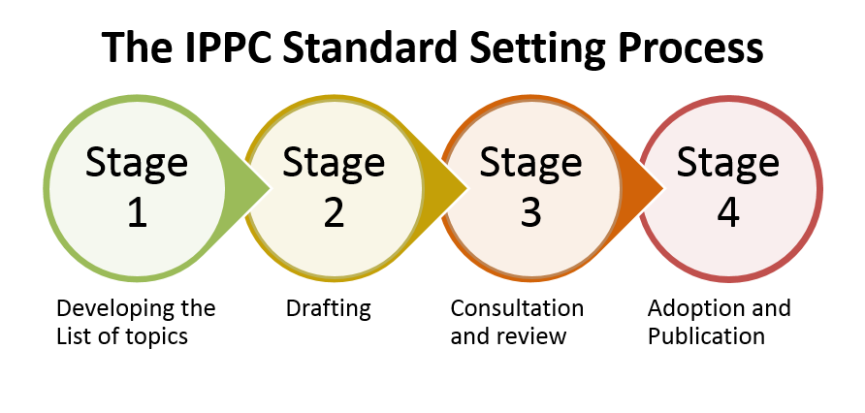

Slide 55
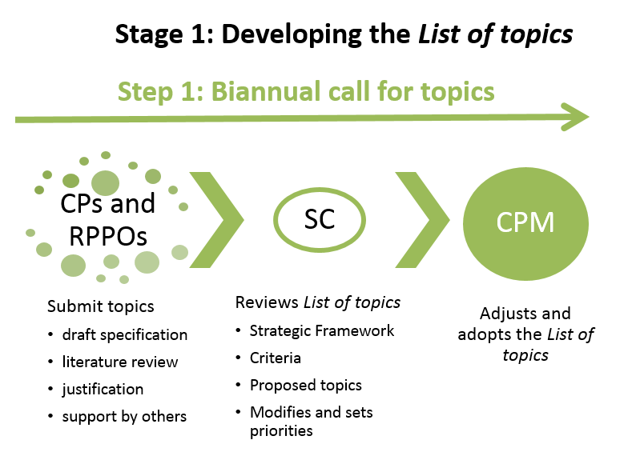

Slide 56
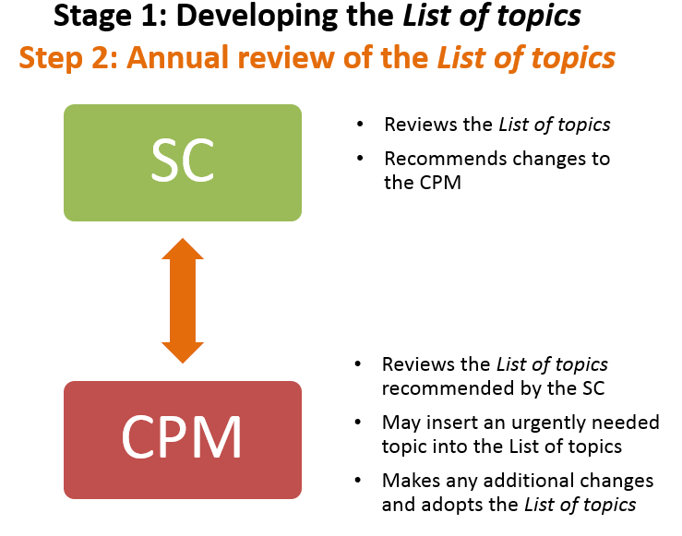

Slide 57
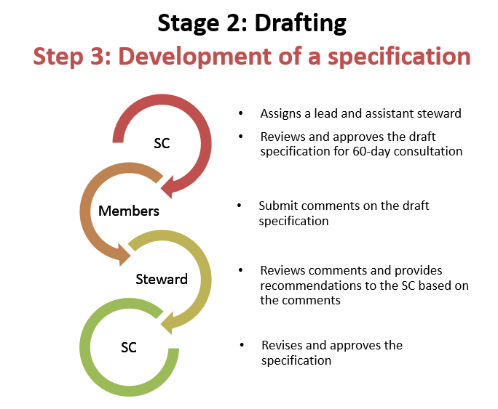

Slide 58
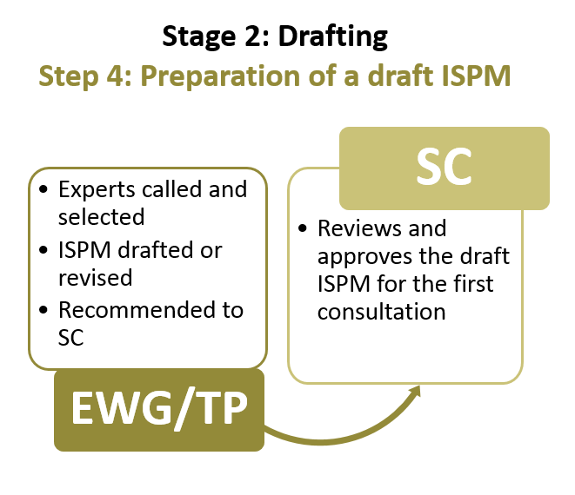

Slide 59
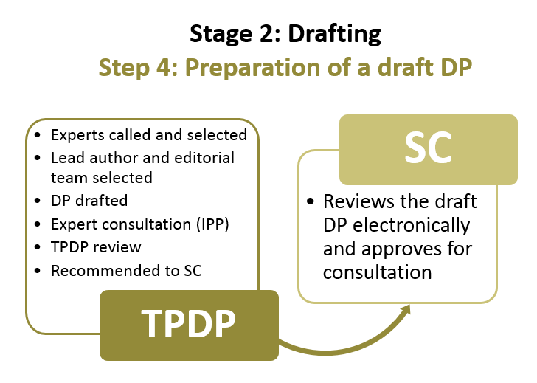

Slide 60
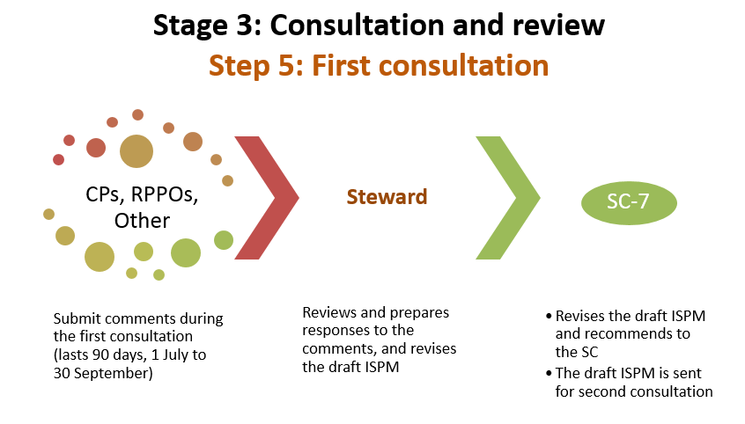

Slide 61
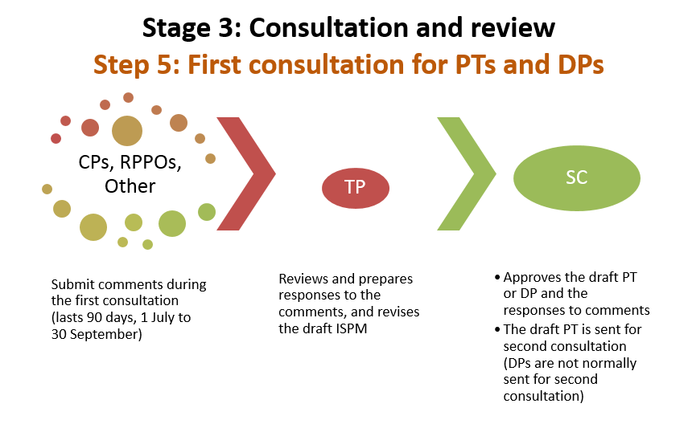

Slide 62
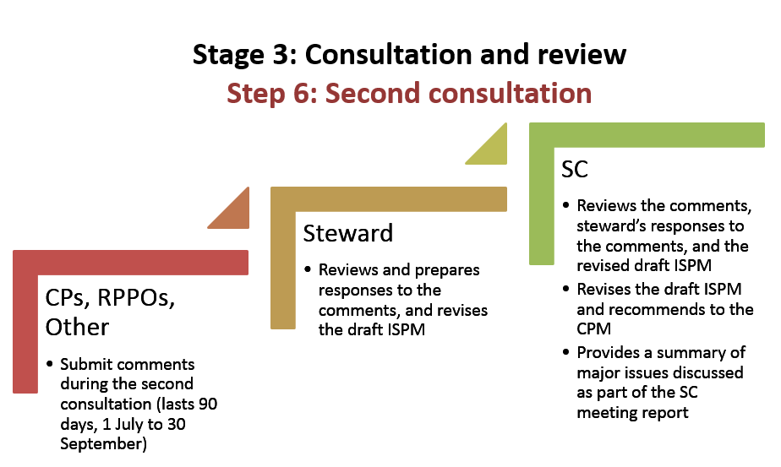

Slide 63
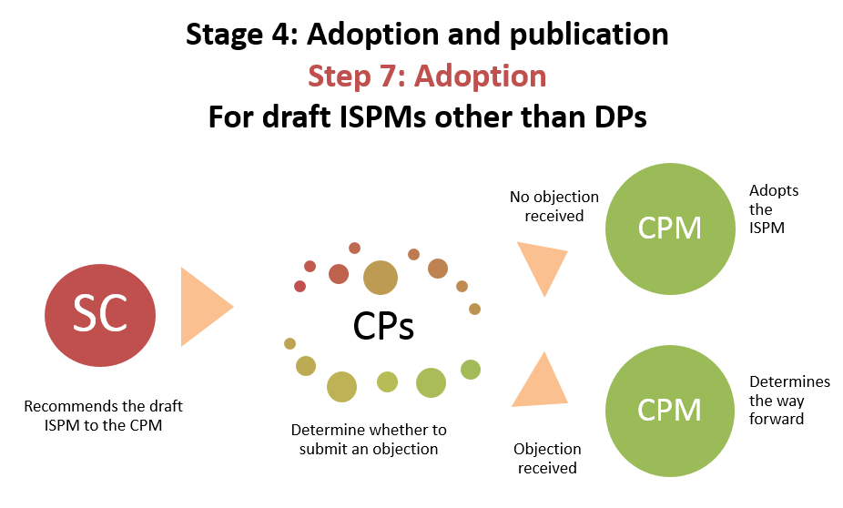

Slide 64
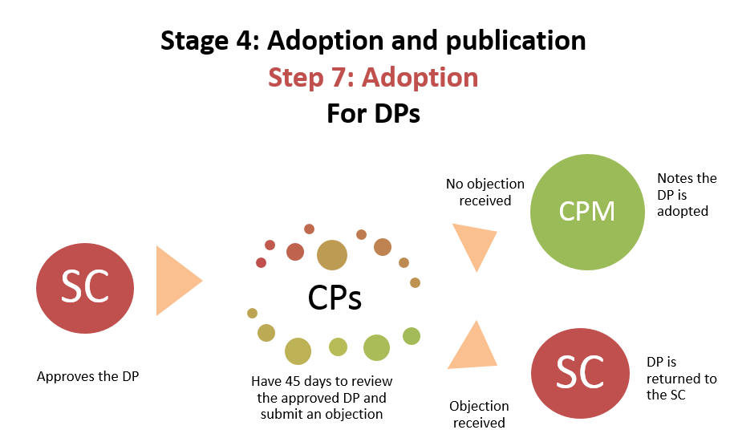

Slide 65
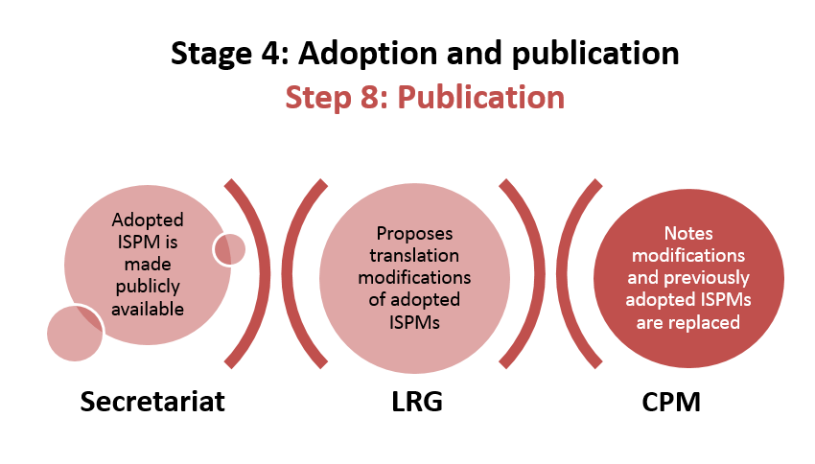

Slide 66
IPPC Standard Setting Process
Standard Setting Training Course 2016

Slide 67
Background of the standard setting process
Originally adopted by the ICPM-2 (1999), revised in 2006, 2008, 2012 based on recommendations provided by a special focus group (FG)
CPM-10 (2015) recommended another review
2015 FG met and recommended improvements
SC, SPG, Bureau, etc. provided input
CPM-11 (2016) approved new process

Slide 68
Why change the process?
Contracting parties are always looking for ways to streamline, clarify, and simplify the process
Past proposed changes include:
Simplifying and clarifying the text (use of plain English)
Clarify who can submit topics to the biannual call for topics
Allow SC to recommend additions to the List of topics for IPPC standards
Changing the length of the consultation periods
Defined who can provide comments during the consultation period

Slide 69
The IPPC
Online Comment System (OCS)
Standard Setting Training Course 2016

Slide 70
OCS Purpose
To provide a simple, efficient, user-friendly online system to insert, share, submit and compile comments on documents

Slide 71
Benefits to the Secretariat and Stakeholders
fast and reliable system
has a simplified layout
is compatible with all major internet browsers and mobile devices
provides direct access for organizations to the documents under review, without requiring Secretariat management of accounts and granting access
provides document navigation more similar to real-world experience of commenting
provides and improved search function for users

Slide 72
System Requirements
Compatible with mobile devices and all major internet browsers

Slide 73
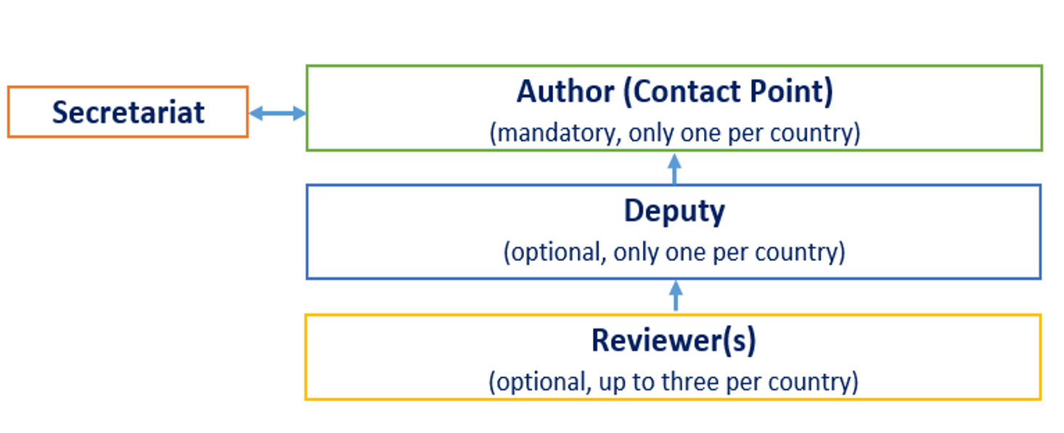
System User Account Types

Slide 74
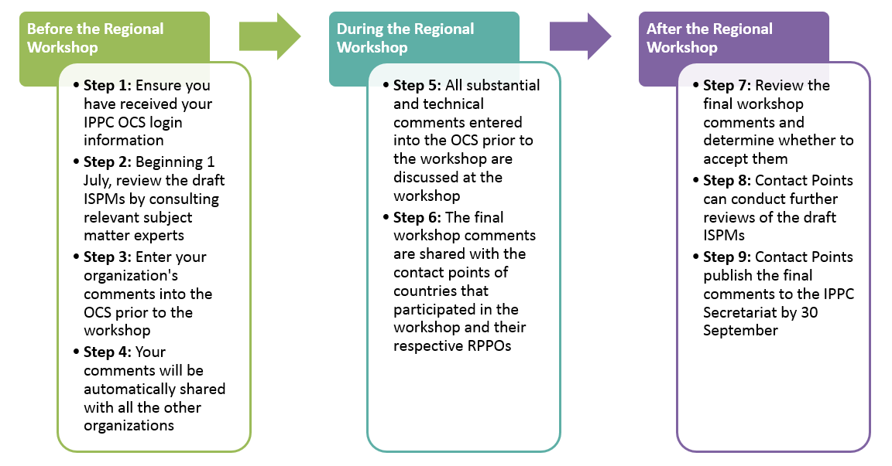
Comments from Regional Workshops

Slide 75
System Contact Information
IPPC OCS Resources Website:
https://www.ippc.int/en/online-comment-system/
IPPC-OCS@fao.org

Slide 76
Questions?

