Slide 1
Bio- security risks posed by sea container pathway in Kenya
Authors: F. koome, T. kosiom, I. Macharia, T. Mutui
Presenter: Koome Kenya Plant Health Inspectorate Service (KEPHIS), P. O. Box 49592-00100, Nairobi, Kenya. director@kephis.org

Slide 2
Movement of sea container in Kenya
Kenya has two international sea port – Mombasa and Malindi ports
The ports serves 7 regional countries
Kenya’s Container Port through put was at 1.2 million TEU in 2017
It is estimated that the through put in 2022 will be 2million TEU

Slide 3
Survey on sea container cleanness in Kenya
In 2019 KEPHIS initiated the sea container cleanness survey at the port and boarder points.
The specific objectives of the survey:
Estimate the nature and the level of bio-contamination in/on sea containers
Determine the overall level of biosecurity risk posed by the sea container pathway in Kenya
Dertimine the effectiveness of the (CTU) code in management of contamination in sea container

Slide 4
The survey approach
The survey is ongoing
Containers are selected from shipping manifests or boarder container movement schedules
Inspection to determine the nature, level and location of contamination is being conducted on both internal and external surfaces.
Data collection is through ODK software based on the questionnaire developed by the IPPC
Samples are being collected for laboratory analysis

Slide 5
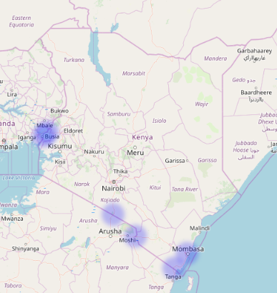
Survey locations
Malaba
Busia
Namanga
Taveta
Mombasa
Lunga Lunga

Slide 6
Number of containers surveyed
789 container were surveyed between April 2019 to Aug 2022.
The container were imported from 54 countries
Year | Number of container surveyed
2019 | 266
2020 | 333
2021 | 65
2022 ( up august) | 125
Total | 789

Slide 7
Level of container contamination
56.3% of all the surveyed containers were contaminated
Number of container surveyed | Number of container with contamination | Number of container without contamination
789 | 444 | 345

Slide 8
Contamination levels: Empty vs pack containers
Number of empty containers surveyed | 242
Number of packed containers surveyed | 547
number of empty container with contamination | 138
Number of packed containers with contamination | 306
Empty Contamination percentage ( %) | 57
Packed containers Contamination percentage ( %) | 56%

Slide 9
Contamination score (where 1 is absent and 5 is high risk)
5% of the container surveyed had high risk level of contaminations
Risk ranking (1-5 where 1 absent and 5 very high) | contamination score | Percentage contamination score (%)
1 | 345 | 43.7
2 | 176 | 22.3
3 | 129 | 16.3
4 | 99 | 12.5
5 | 40 | 5.0
Grand Total | 789

Slide 10
Nature of contamination
Soil highest contaminant- 53.8%, plant materials 30.9%, arthropods 5.8%
Nature of contamination | Number of contaminated containers | Contamination Percentage (%)
Animal/animal material-feathers, faeces | 7 | 1.6
Plant material | 137 | 30.9
Soil | 239 | 53.8
Seeds | 22 | 5
arthropods | 26 | 5.8
Egss/egg mass | 9 | 2.0
Others | 11
 |  | 2.4

Slide 11
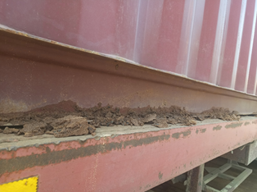
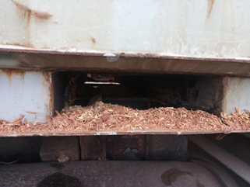
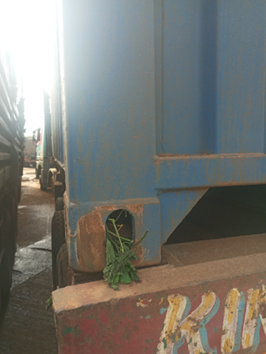
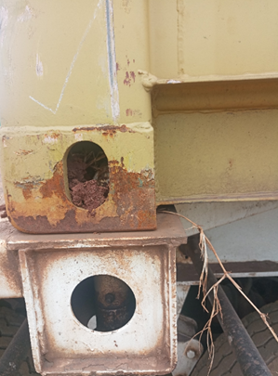
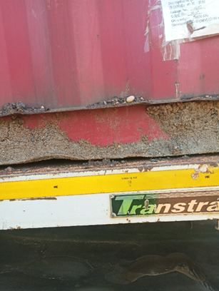
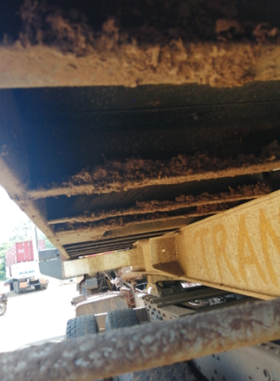
Results: contamination

Slide 12
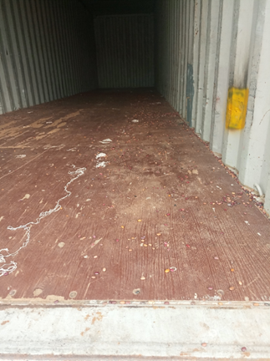
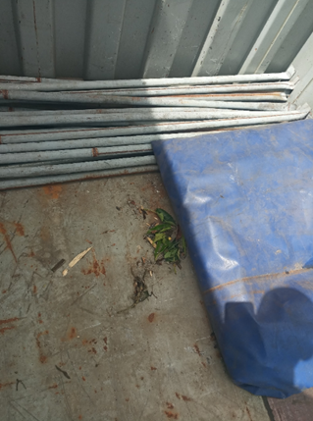
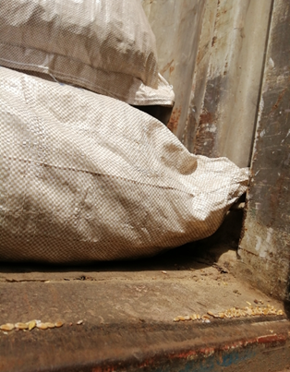
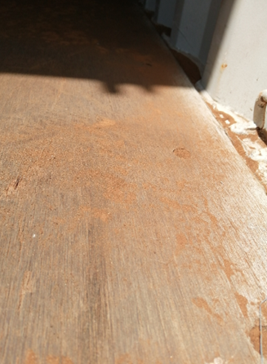
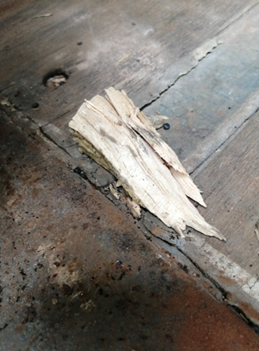
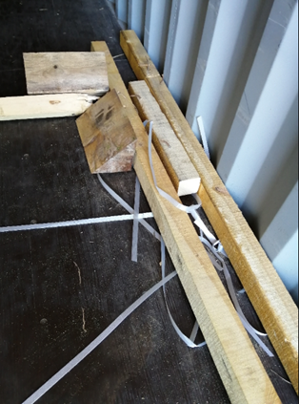
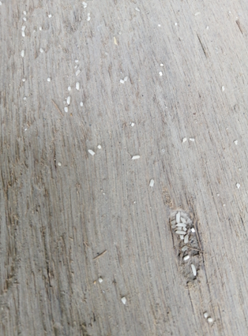
Results: contamination

Slide 13
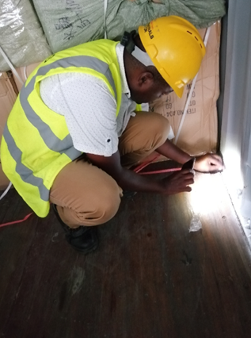
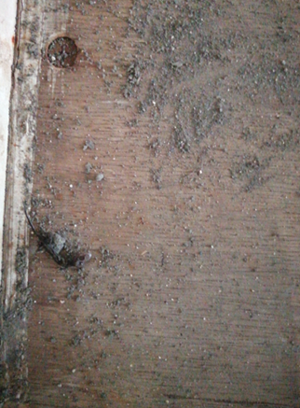
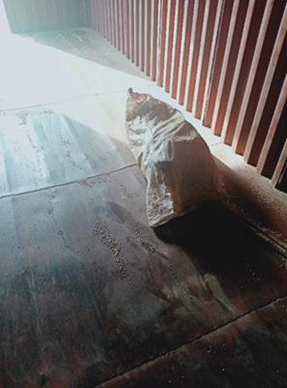
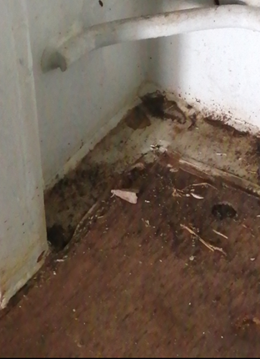
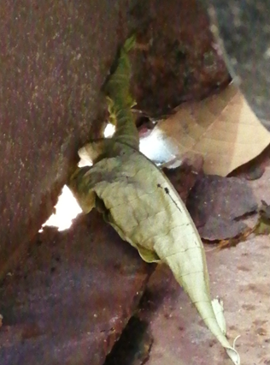
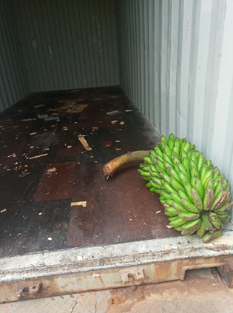
Results: contamination on the interior surface

Slide 14
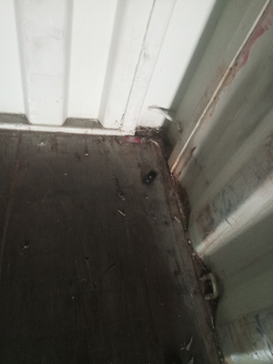
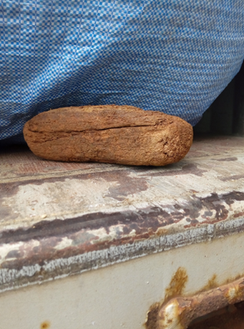
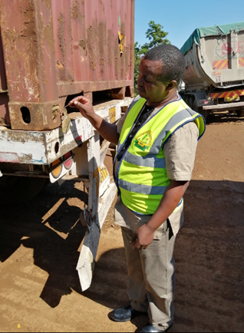
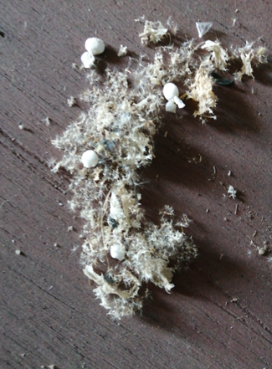
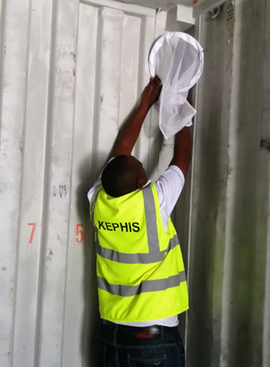
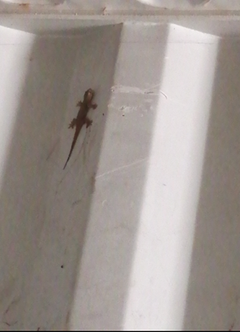
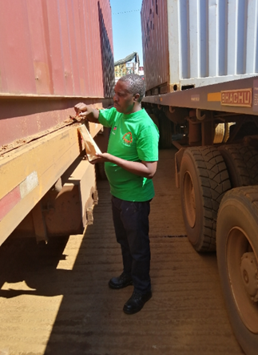
Results: contamination

Slide 15
Conclusion
Full external and internal inspections of all containers on arrival is impractical
The risks associated with the pathway are diverse and not likely to be adequately mitigated by application of a single measure.
Current mitigations measures (CTU code) put in place by shipping industry to manage contamination in sea containers are not adequately addressing the challenge.
Based on the findings of this survey, it is clear that the sea container pathway poses significant plant bio-security risk to Kenya

Slide 16
Recommendations
Awareness creation on bio- security risk posed by sea container pathway
To consider offshore certification of sea container
Review of CTU code
Returning containers from regional countries to be cleaned in their respective countries.

